Slide 1

SEEING THE FOREST FOR THE TREES BUILDING FULLY FEATURED Hybrid MOBILE APPS
Matt Netkow
The SAVO Group
@dotNetkow
netkow.com
That Conference 2014

Slide 2
About me
Senior Developer for The SAVO Group – 5 years
Sales Productivity SaaS
Backend .NET C# development: user/document automation, tools
Mobile app development for Netkosoft – 1 year
Focus on front-end development
Entirely PhoneGap-based, Hybrid apps
Team of Two (Partnered with Graphic Designer)
Netkow.com Blog
Technology trends, programming, PhoneGap

Slide 3


Journey to mobile app
An idea emerges…
+
=
PROFIT!
(hopefully)
Fitbit user Weight Watchers member ???
Desired Outcome:
Challenging calorie tracking, WW points, & motivational weight loss
Available for iOS, Android, and Windows Phone 8
Charge for the app
Fast development cycles

Slide 4
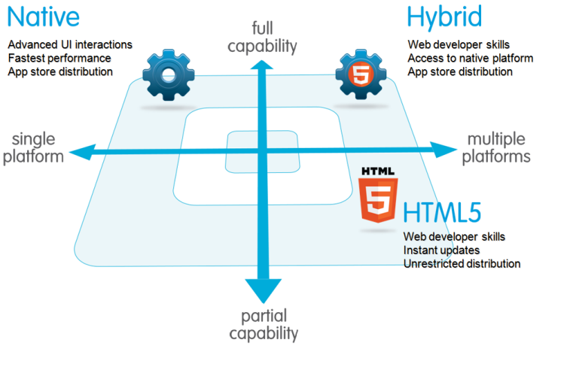
Which technology to use?
Notes:
Add arrow pointers to each, 1 by 1?

Slide 5
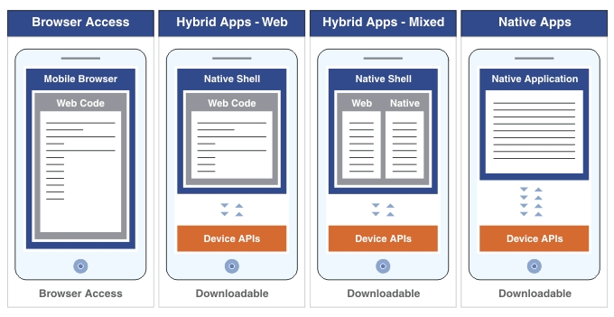
Creating an app- comparison
Notes:
Keep this? Is slide before hand enough?

Slide 6
Why hybrid? business
- BYOD trend still gaining momentum
- mobile work styles across many industries
- cost: portability, less maintenance
- by 2016, > 50% of mobile apps will be hybrid (Gartner)

Slide 7
Why hybrid? personal
- increasingly more opportunities: web technology increasing across devices (tv's, cars, watches (Pebble: javascript)...)
- consistently getting better, easier to break into
- career: developers who are strong in both frontend & backend are desirable

Slide 8

Why Hybrid? technology
Use existing HTML5, CSS3, JavaScript knowledge
Native optional!
Full Capabilities: Device APIs
Multiple Platforms: iOS, Android, Windows Phone

Slide 9




Tools used
Sublime Text 3:
development
PhoneGap Build:
Cloud-based PhoneGap service
Native apps created for you!
Kendo UI Mobile for PhoneGap:
Automatic platform styling
Fast implementation
Core features now open-source!
Current Test Devices:
iPad mini Retina
Samsung Galaxy S3
Lumia 1020
Notes:
Remove this slide? Keep PGB and kendo icons though

Slide 10

Mission accomplished
+
=
Fitbit user Weight Watchers member Fitwatchr
Notable Features:
Initial version created in days
Available for iOS, Android, and Windows Phone 8
Price varies: from $0.99 to $2.99
10,000 paying users in 1 year
Notes:
Move this to end of PhoneGap Build portion?

Slide 11
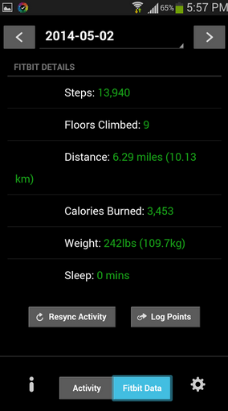
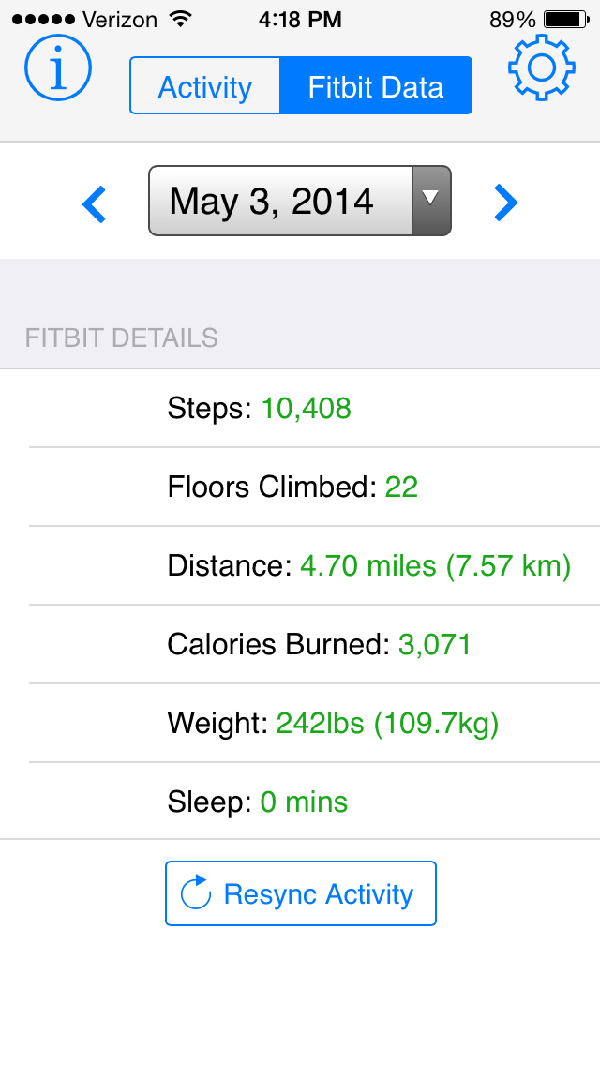
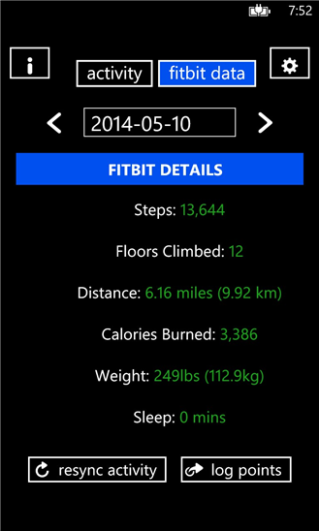
Mission accomplished
Android iPhone Windows Phone
Notes:
Move this to end of PhoneGap Build portion?

Slide 12
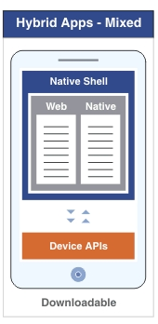
Creating a Hybrid app: Parts?
Web:
All app logic (JavaScript)
Layout (HTML)
Styling (CSS)
Native & Native Shell:
Compiled app
Device APIs
Notes:
In order to create an app, we have two major parts: Web and Native.

Slide 13
Web: app logic in JavaScript
Create classes, libraries
Unit testing
Frameworks are fine
Angular, Knockout, Backbone
No surprises here!

Slide 14
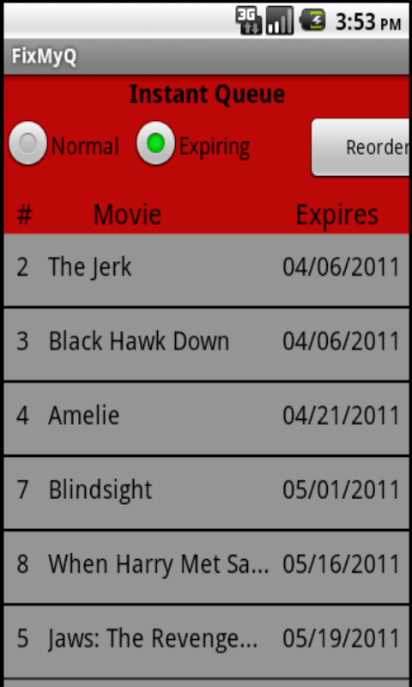
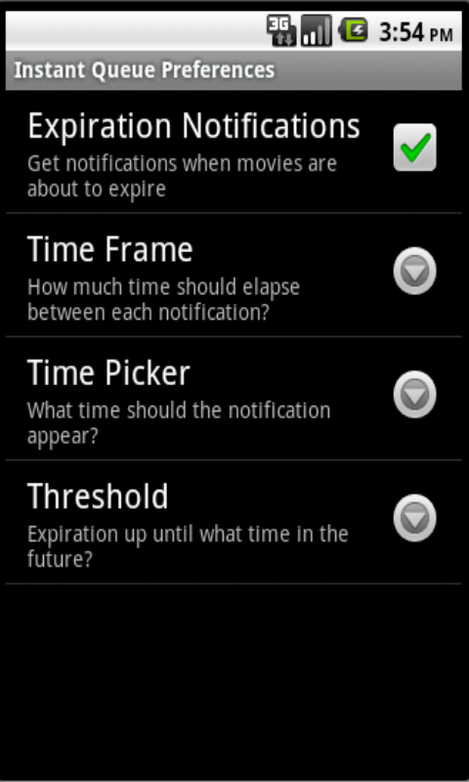
Web: layout & styling
Most developers are not good designers…

Slide 15
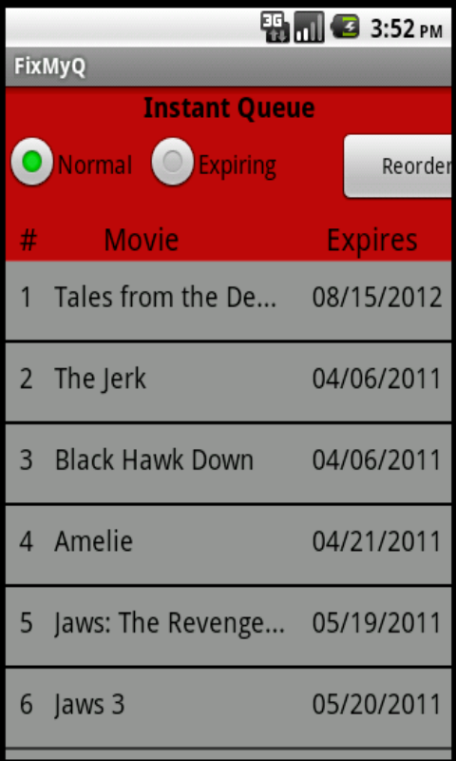
Web: layout & styling
Challenging to accomplish:
A native look
Touch friendliness
Responsiveness across
many devices
Phone:
Tablet:

Slide 16



Web: layout & styling The solution?
Let a mobile framework do the heavy lifting!
Notes:
Add animation to select kendo ui

Slide 17
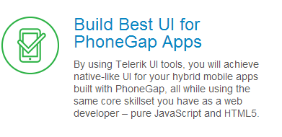
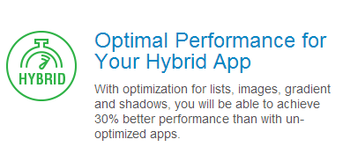

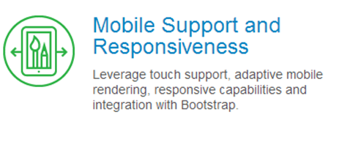
Kendo UI Mobile

Slide 18
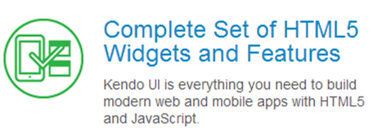
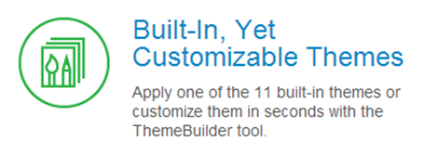
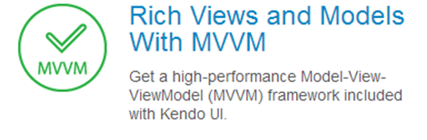
Kendo UI Framework
Demo
Notes:
KendoUI Mobile is part of the larger KendoUI framework suite

Slide 19
Responsive?
TODO code sample

Slide 20
Much better!
Without:
With:

Slide 21
Kendo ui: cost?
~$700 early 2013
$199 late 2013
Free/open-source, April 2014

Slide 22
From web to native app
Notes:
How do we transform our web app into a native one? TODO red boxes around native parts

Slide 23
From web to native app
PhoneGap
Implements native “wiring” for you
Provides access to device features via JavaScript API’s
Individual Platform SDKs required
PhoneGap Build
cloud service that creates native app & injects PhoneGap into it
No SDKs, compilers, or hardware (iOS requires a Mac)
1 private app free!

Slide 24
phonegap build: features
Plugins
Fill in missing native functionality:
Camera interaction
In-app Browser
Google Analytics
Hydration
Automatically deploy new app versions to devices
Useful individually or with a team
Remote debugging
Review app code, storage, etc. all in real-time
Debug plugin behavior
demo

Slide 25
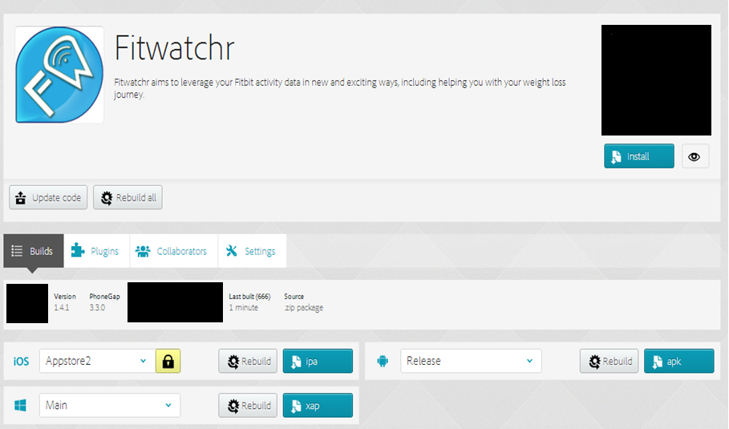
NOTABLE PHONEGAP BUILD FEATURES
Easily build multiple versions of app from same codebase:
Notes:
TODO: prep other slides like this in case of No Internet

Slide 26
Creating a Hybrid app: recap
Web:
All app logic (JavaScript)
Layout (HTML)
Styling (CSS) via Kendo UI Mobile
Native & Native Shell:
Compiled app via PhoneGap Build
Device APIs: PhoneGap
Notes:
Using KendoUI Mobile, PG Build and PhoneGap we cover all the parts of a hybrid app!

Slide 27
Hybrid app performance
Hardware: natural improvements over time; incredibly powerful phones now (TODO graph?)
Software: apps run in WebViews
- Apple: big improvements between iOS 7 and 8 Javascript performance, 4.5x faster with new WebView; webGL;
- Android: v4.4 has new WebView version based on Chromium
May never be the exact same as native - consider what is "good enough". can you really measure milliseconds personally?
TODO: recommendations for types of apps: business, consumer, utilities, games (move to key takeaways?)

Slide 28
Conclusion / thoughts
Great time to invest in web skills
Multitude of devices
Significant Adobe-backed investments
Better and better tooling:
PhoneGap Developer App
Brackets
Buy at least one test device
Hint: Start with your own phone!
Kendo UI Mobile
For designers and non-designers alike!

Slide 29
Questions?
Matt Netkow
Developer/Founder, Netkosoft
www.netkow.com
@dotNetkow
matt.netkow@gmail.com
PhoneGap Blog Guest post

